Slide 1
Week 4
Stress

Slide 2
Warm Up Discussion
What’s the most dangerous animal in the world?
What’s the best type of animal to have as a pet?

Slide 3
Review
What are contractions?
Words that have been combined or shortened
They are used in all spoken communication unless someone is speaking very formally or is trying to make a point
Examples: He's, She's It's, They’re, I’ve, etc.

Slide 4
Pronunciation
He is | /hi:/ /Iz/
He’s | /hi:z/
She is | /ʃi:/ /Iz/
She’s | /ʃi:z/
It is | /It/ Iz/
It’s | /Its/
/ts/ combination: http://www.rachelsenglish.com/videos/how-make-ts-sound)

Slide 5
Stress
English is a stress timed language
  Some syllables and words are long
  Others are short
The words are “part of the whole” message
  For native speakers, our ears automatically listen only for the emphasized pieces
  We shouldn't listen for each word individually, just for the stressed sounds to recognize the important information

Slide 6
Important Definitions
Strong Form
  Vowels spoken loudly, clearly, and correctly in their full form
  Vowels are spoken in the strong form in stressed syllables and words
Weak Form
  De-emphasized vowel sounds in non-stressed syllables and words
  Spoken more quietly, without emphasis
  Vowel sounds are often replaced with the /ə/ sound

Slide 7
Types of Stress
Word Stress (syllable stress)
  Emphasizing one syllable per word
  De-emphasizing the non-stressed syllables
Sentence Stress
  Emphasizing the important words in a sentence
  De-emphasizing the unimportant words

Slide 8
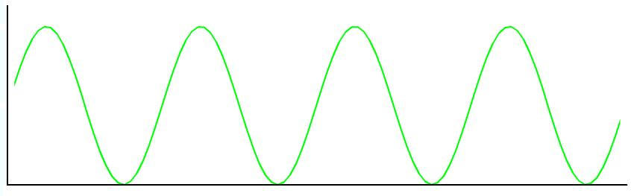
Contrast
In English there is always a contrast.
Some sounds and words are spoken loudly and clearly, and others are spoken more quietly and reduced.

Slide 9
Word Stress
Emphasizing one syllable per word
In English, not all syllables are pronounced equally
One syllable is pronounced in the strong form (loudly, clearly, sometimes longer)
The other syllables are pronounced in the weak form
Example: banana

Slide 10
Exercise
Listen and place the word in the correct column based on its stress pattern
* | *_ | _* | _*_
talked | started | increased | invited
launched | finished | advised | expanded
stopped | needed | improved | exported
worked | offered | received | promoted

Slide 11
Rules
Stress on first syllable
  Most two syllable nouns and adjectives (butter, pretty)
Stress on last syllable
  Most two syllable verbs (begin, produce)
Stress on penultimate syllable (second syllable from the end)
  Words ending in ‘ic’ (realistic)
  Words ending in ‘sion’ (tension)
  Words ending in ‘tion’ (solution)
Stress on anti-penultimate syllable (third syllable from the end)
  Words ending in ‘cy’, ‘ty’, ‘phy’, and ‘gy’ (democracy, reliability)
  Words ending in ‘al’ (critical, economical)

Slide 12
Strong Advice
Don't study the rules! They are complicated
Learn through awareness
  Understand the concept of word stress
  Listen for the “rhythm” of the language
Practice listening to native speakers to understand the rhythm of natural English speech

Slide 13
Strong vs. Weak Form
Which syllable is stressed in the word “Canada”? Ca-na-da
  Canada
Phonemic Spelling
  /Kæ-nə-də/
The stressed syllable pronounces the 'a' in the full form /æ/
The unstressed syllables pronounce the 'a's in a reduced form, substituting the /ə/ sound instead

Slide 14
Reduction of /ə/
Listen for the /ə/ sound in the unstressed syllables
_ * | _ * _ | * _ _
Promote | Attractive | Quality
Success | Consumer | Holiday

Slide 15
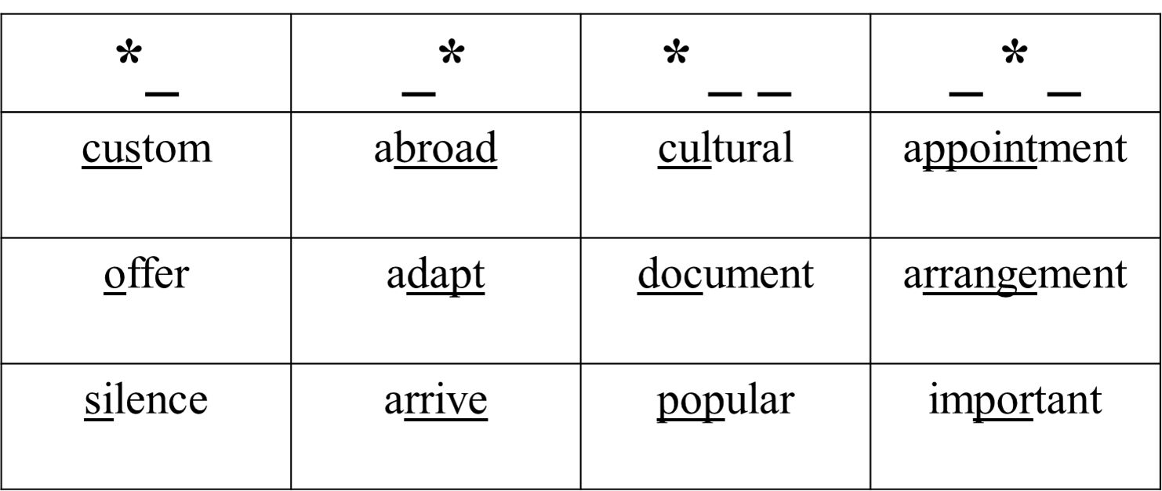
Exercise
Place the word in the correct column based on its stress pattern. Then listen for the /ə/ substitution in the unstressed syllables

Slide 16
Sentence Stress
The rise and fall of your voice on certain words as you speak
Emphasize the words that carry the most information and are important for the meaning
  Words are spoken loudly, clearly, in the strong form
  No linking reductions, or contractions
De-emphasize the words that are not important to the meaning

Slide 17
Content Words
Words that carry information. You need these words to understand what the person is talking about.
Nouns
Main Verbs
Adjectives
Adverbs

Slide 18
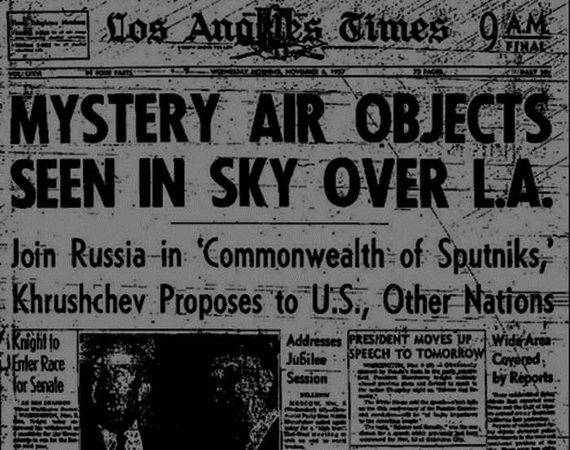
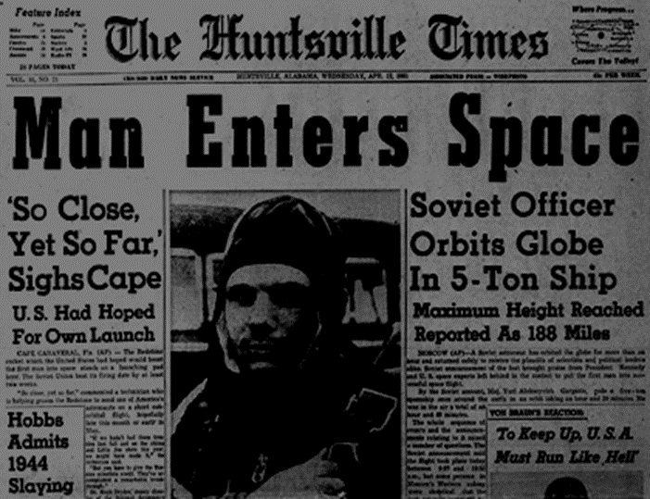
Content Words
Think about newspaper headlines. Only the important words are used to catch your attention. These are the content words

Slide 19
Structure Words
Words that don't carry any information, they are only used for proper grammar
Pronouns
Prepositions
Articles
Auxiliaries (be, can, could, do, have, may, might, must, need, shall, should, will, would)
Conjunctions (and, or, but)

Slide 20
Reduced Speech
Reducing structure words to highlight the importance of the content words
Linking: Joining words
Reductions: Speaking words in a “weak form”
Contractions: Combining words by removing certain letters

Slide 21
Reductions
We de-emphasize the structure words to highlight the importance of the content words
The structure words can be spoken in a weak form since they aren't important to the meaning
Full Form | Pronunciation | Example
For | /fə/ | “It's /fə/ him.”
Have to | /hæftə/ | “I /hæftə/ go”

Slide 22
Summary
Stress is important because it tells us what sounds and words need to be pronounced clearly and what can be reduced
Remember that native speakers are listening for stress patterns so it can be difficult to understand if you speak each syllable and word with the same emphasis
http://rachelsenglish.com/videos/english-stress-timed-language

Slide 23
Speaking
What’s the best way to reduce stress in your life?
Would you prefer to own your own business or work for a company?
Which is more important in your life, family or achievement in your career?
Why do you think football is the most popular sport in the world?

